Slide 1


HEP NTUA Weekly Report 23/6/2021
George Bakas

Slide 2
Summary
ttX analysis:
Still haven’t got all the files → 2016_preVFP just arrived
Integration of 2016_preVFP into our pipeline
Signal Extraction → We have minor differences with Giannis but we want to make sure we have exactly the same output
Combination of all years in Fiducial level
Combination of Efficiency and Acceptance
Unfolding
Planning a ttX presentation within early July
Z’ analysis
Integrated 2016_preVFP files into workflow for this analysis (mJJ cuts, etc)
JES variations for 2016_preVFP, 2017 and 2018
Combination of datacards
Result on all channels (years)
Mass Cut Mapping :
{"mZ_1200_12":1000, "mZ_1400_14":1200, "mZ_1600_16":1400, "mZ_1800_18":1600, "mZ_2000_20":1600, "mZ_2500_25":2000, "mZ_3000_30":2000, "mZ_3500_35":2000, "mZ_4000_40":2000, "mZ_4500_45":2000}
Expectation Ratio (over 2018 result for example as reference) in order to check consistency of combined result

Slide 3
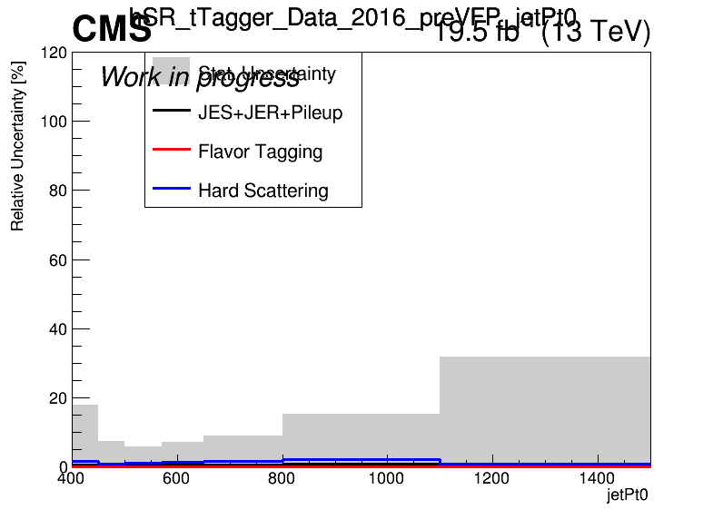
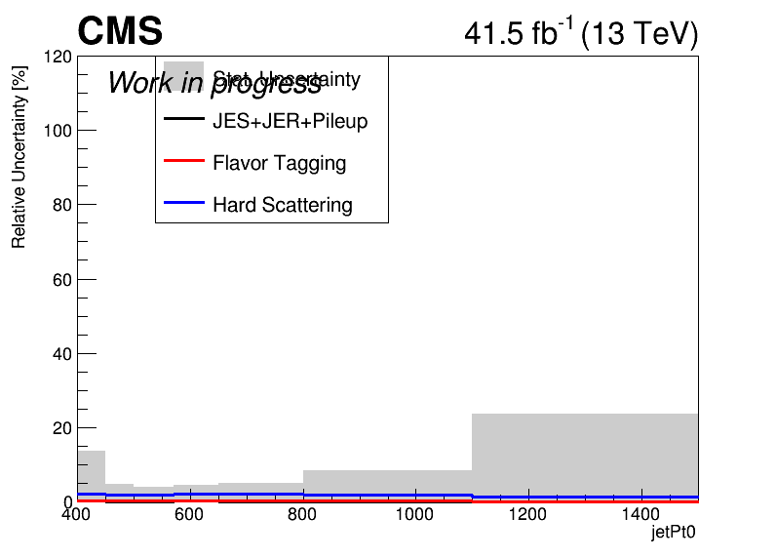
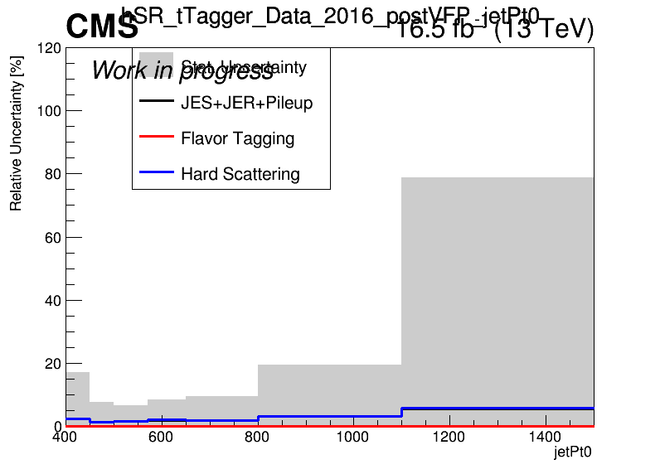
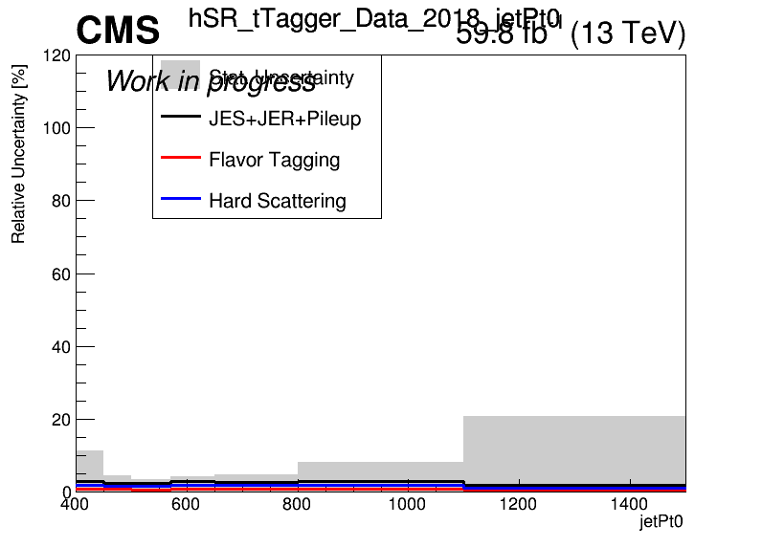
Errors in Fiducial Signal Extraction (Work In Progress)
2016_preVFP
2017
2016_postVFP
2018

Slide 4
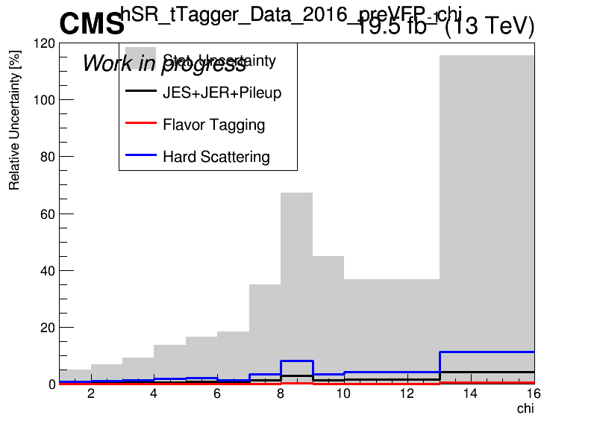
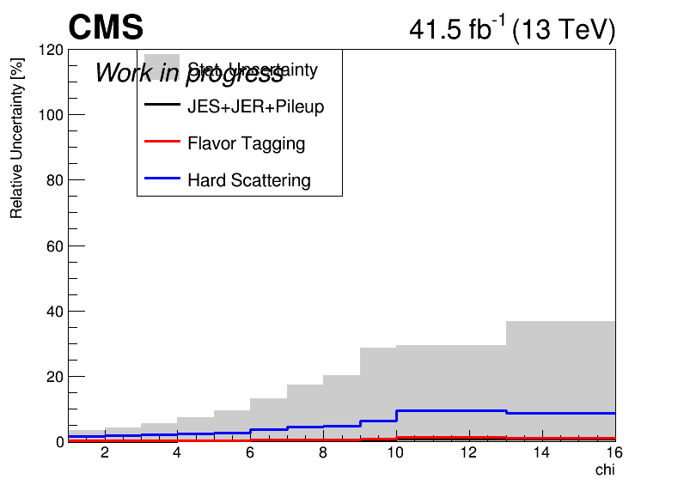
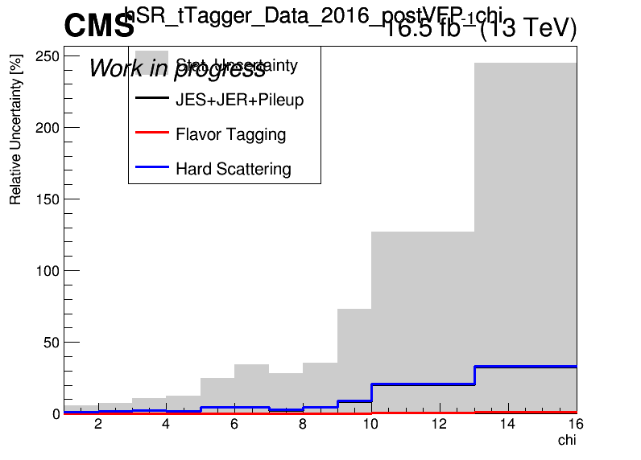
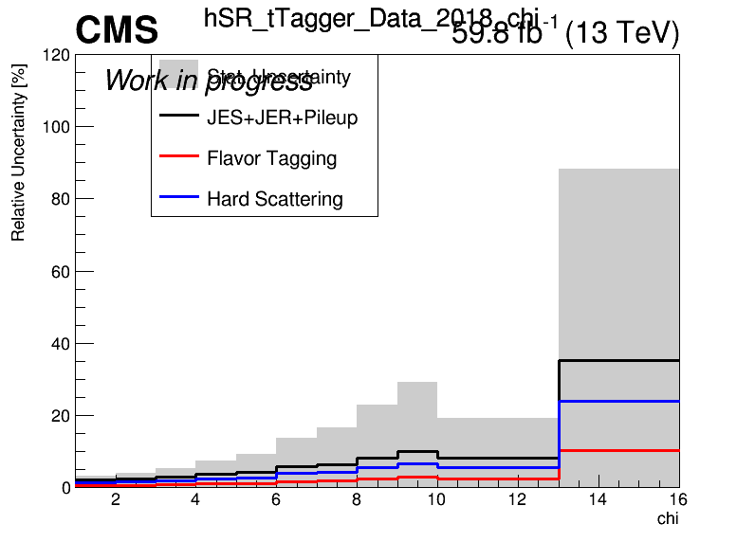
Errors in Fiducial Signal Extraction (Work In Progress)
2016_preVFP
2017
2016_postVFP
2018

Slide 5
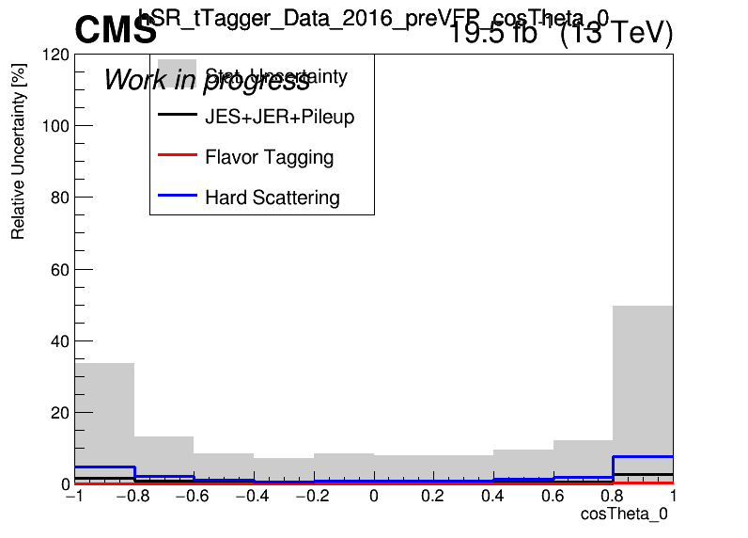
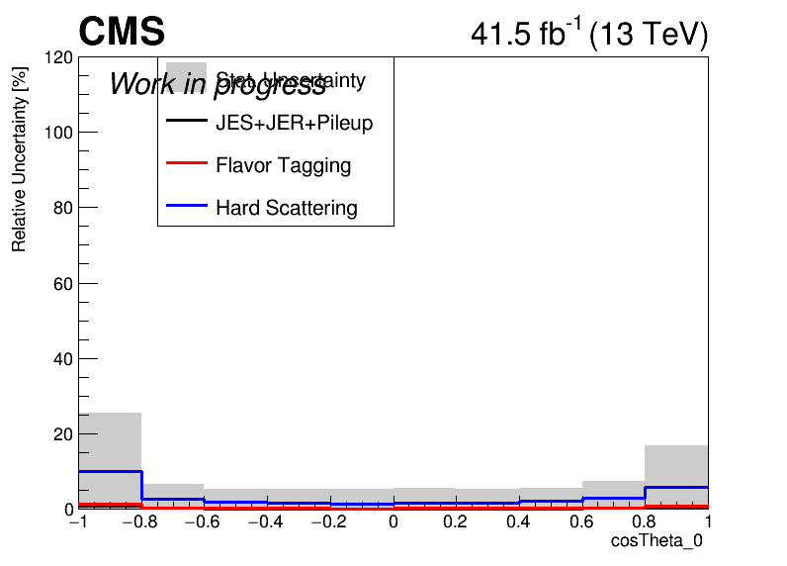
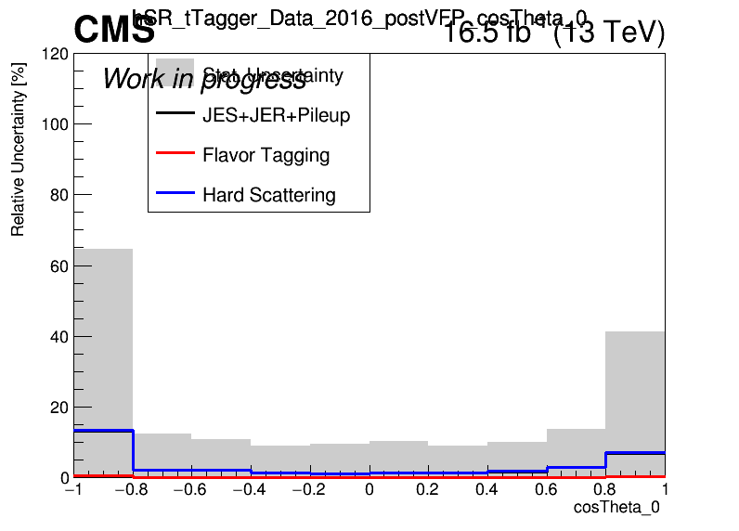
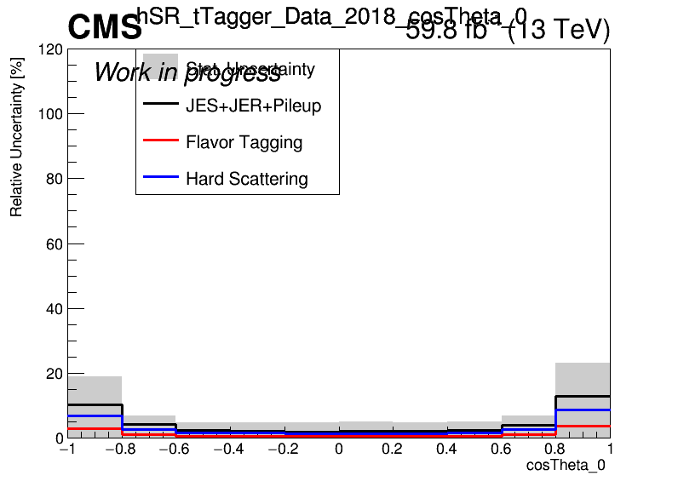
Errors in Fiducial Signal Extraction (Work In Progress)
2016_preVFP
2017
2016_postVFP
2018

Slide 6
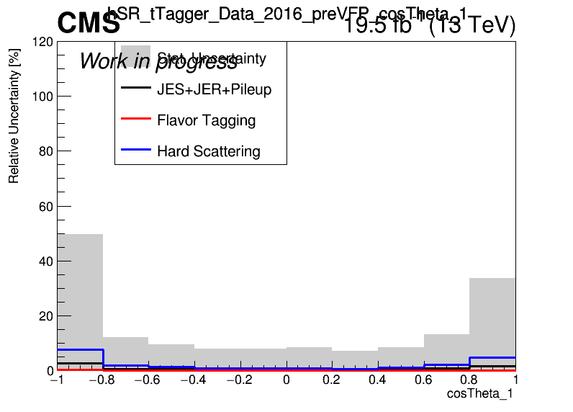
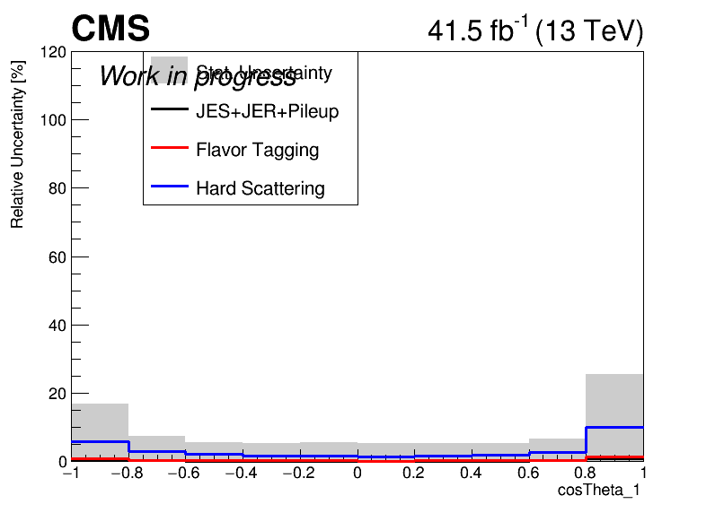
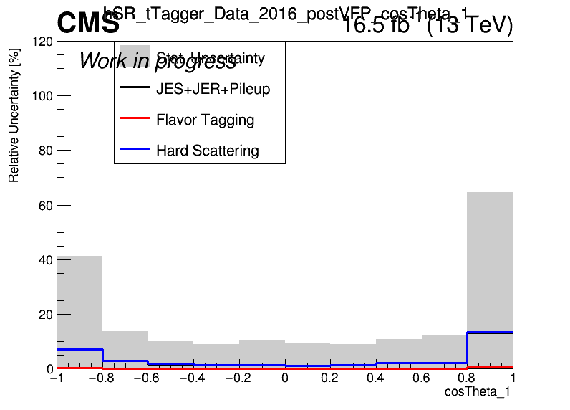
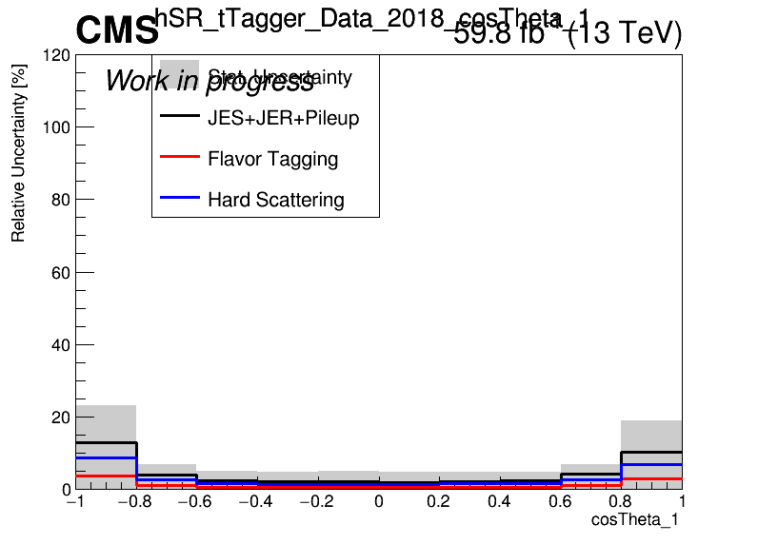
Errors in Fiducial Signal Extraction (Work In Progress)
2016_preVFP
2017
2016_postVFP
2018

Slide 7
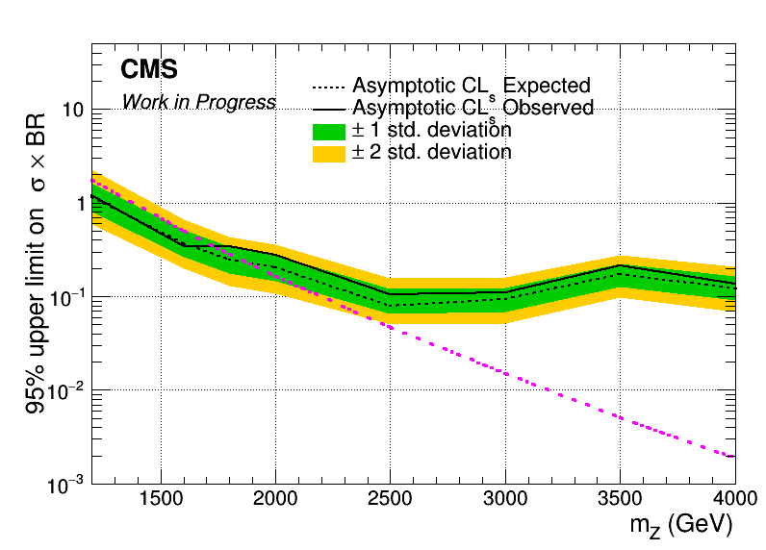
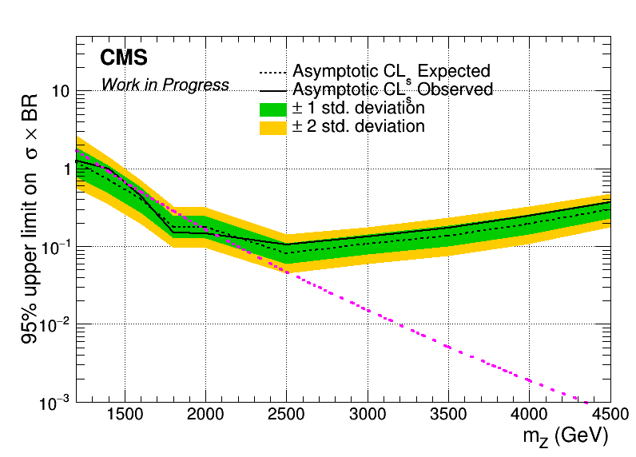
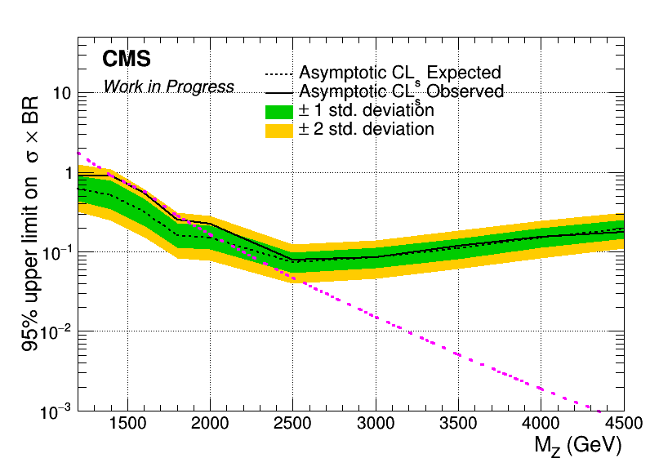
Brazilian Plots (2016_preVFP, 2017 and 2018) with sliding mJJ Cut
2016_preVFP
2017
2018

Slide 8
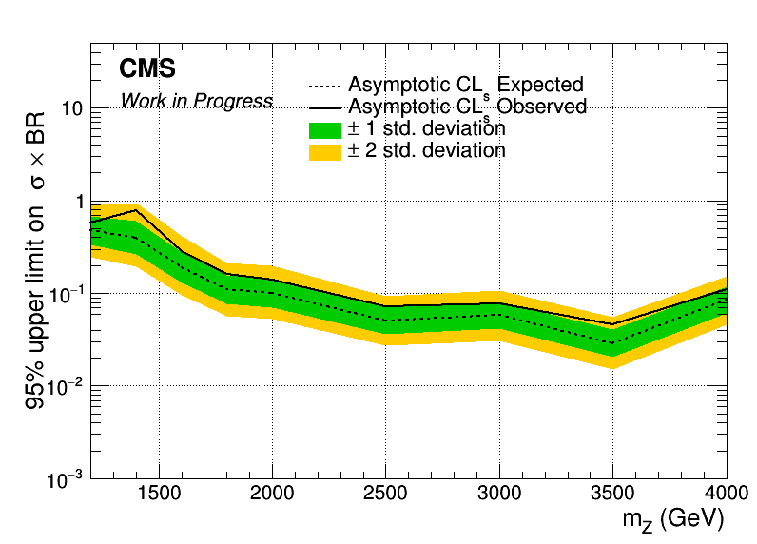
Combined Datacard for 2016_preVFP, 2017 and 2018
Mass Cut Mapping
{"mZ_1200_12":1000, "mZ_1400_14":1200, "mZ_1600_16":1400, "mZ_1800_18":1600, "mZ_2000_20":1600,
"mZ_2500_25":2000, "mZ_3000_30":2000, "mZ_3500_35":2000, "mZ_4000_40":2000, "mZ_4500_45":2000}

Slide 9
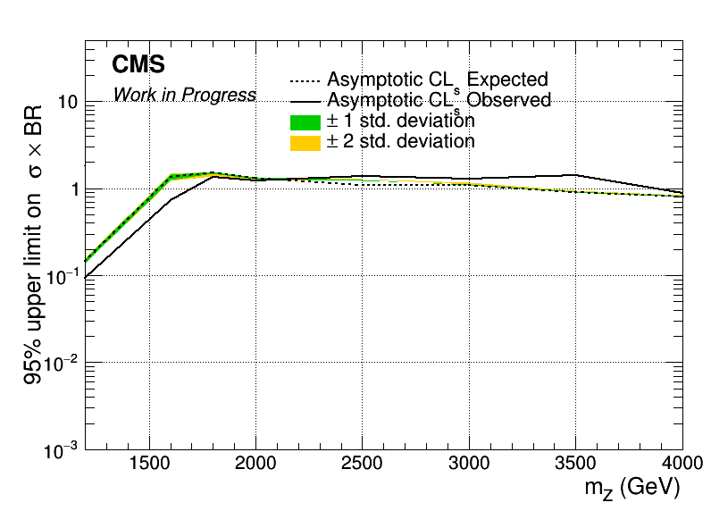
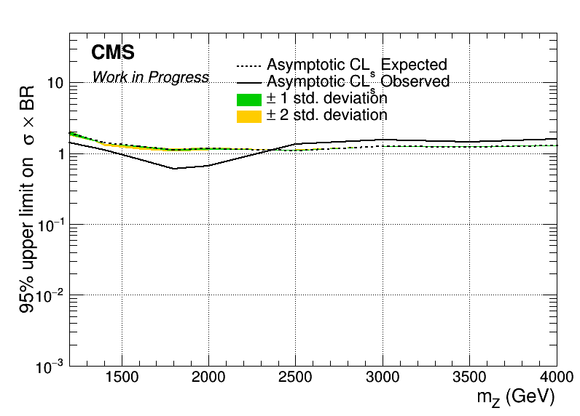

Brazilian Plots (2016_preVFP, 2017 and 2018) with sliding mJJ Cut wrt 2018
2016_preVFP
2017
2018

Slide 10
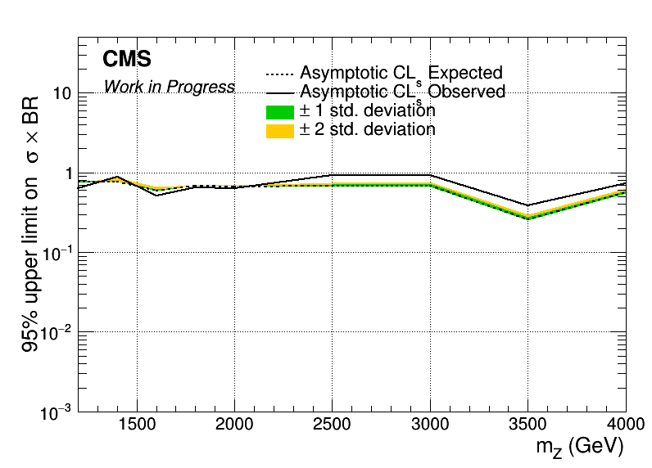
Combined Datacard for 2016_preVFP, 2017 and 2018 wrt 2018
Mass Cut Mapping
{"mZ_1200_12":1000, "mZ_1400_14":1200, "mZ_1600_16":1400, "mZ_1800_18":1600, "mZ_2000_20":1600,
"mZ_2500_25":2000, "mZ_3000_30":2000, "mZ_3500_35":2000, "mZ_4000_40":2000, "mZ_4500_45":2000}

Slide 11
BACKUP

Slide 12
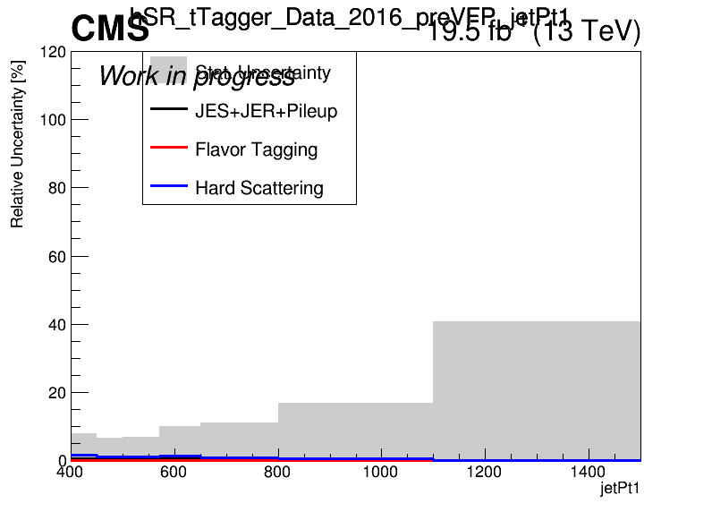
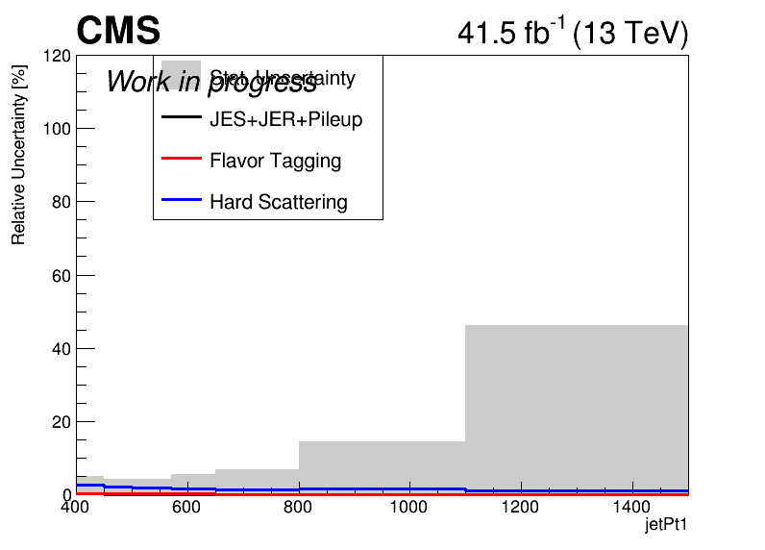
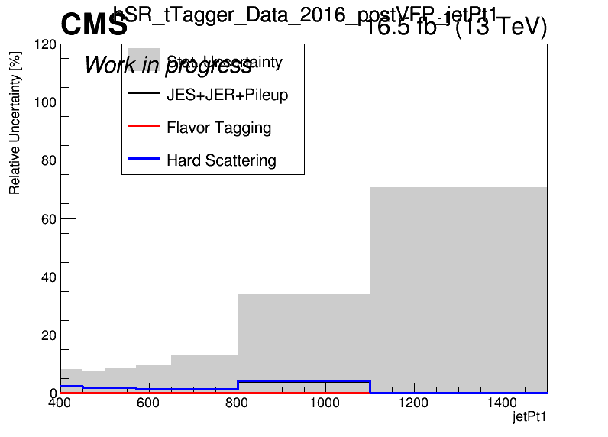
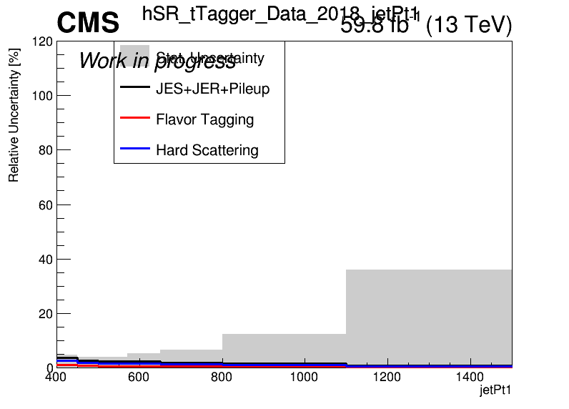
Errors in Fiducial Signal Extraction (Work In Progress)
2016_preVFP
2017
2016_postVFP
2018

Slide 13
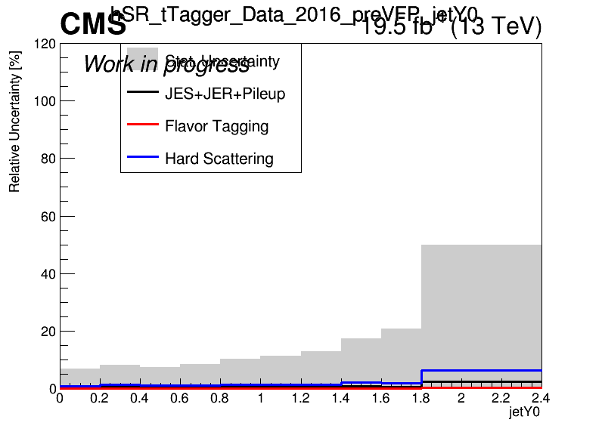
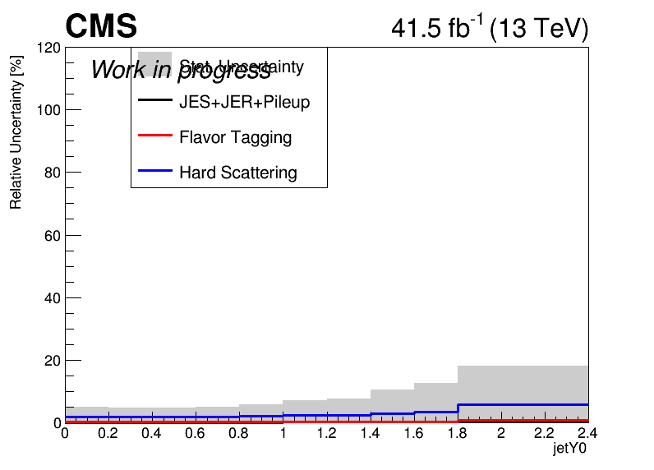
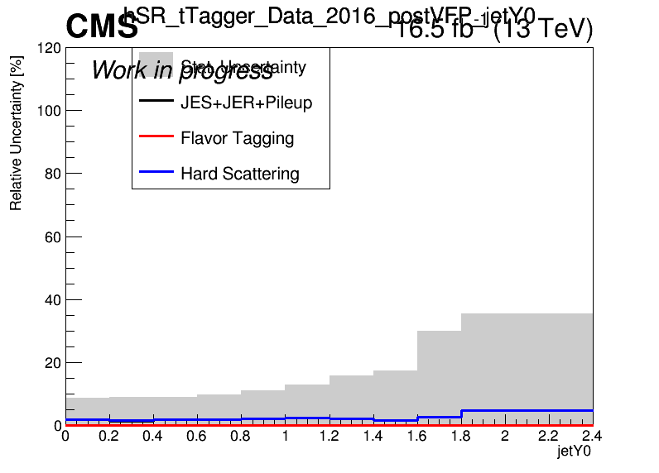
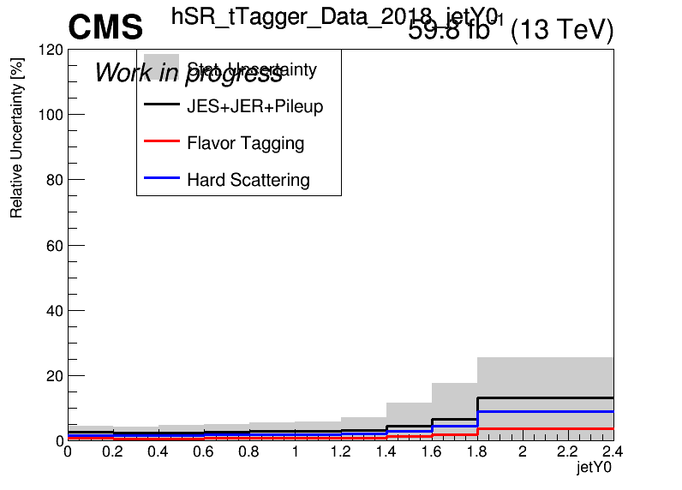
Errors in Fiducial Signal Extraction (Work In Progress)
2016_preVFP
2017
2016_postVFP
2018

Slide 14
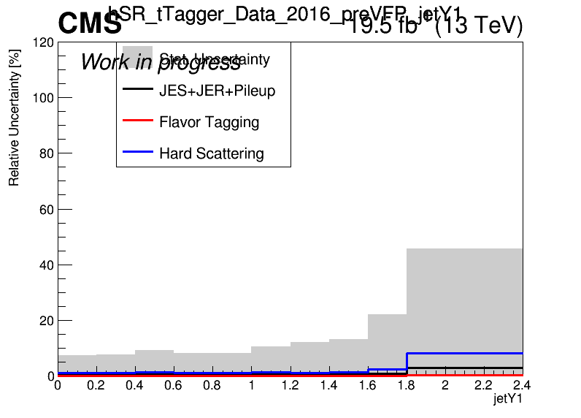
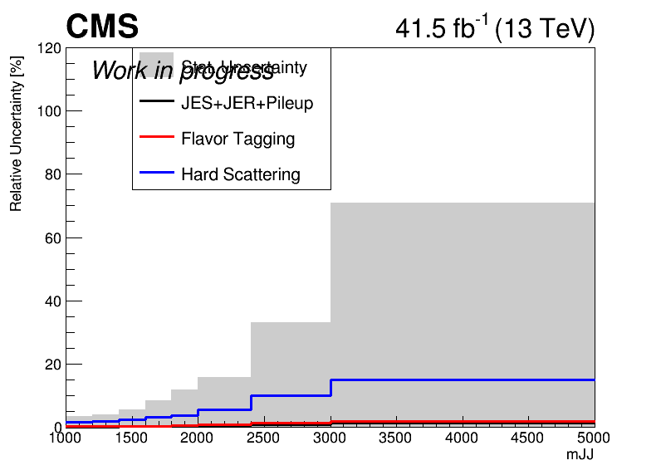
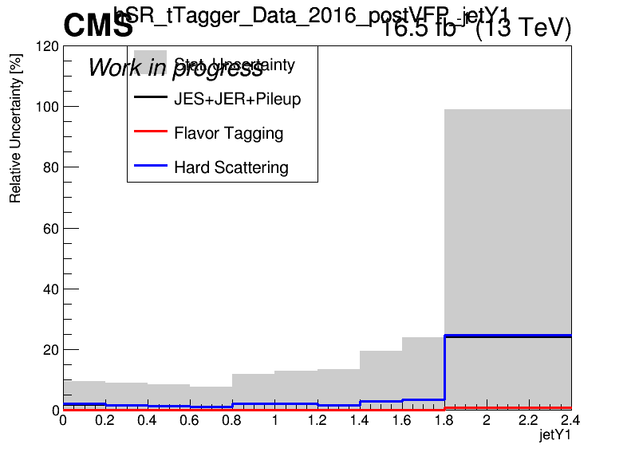
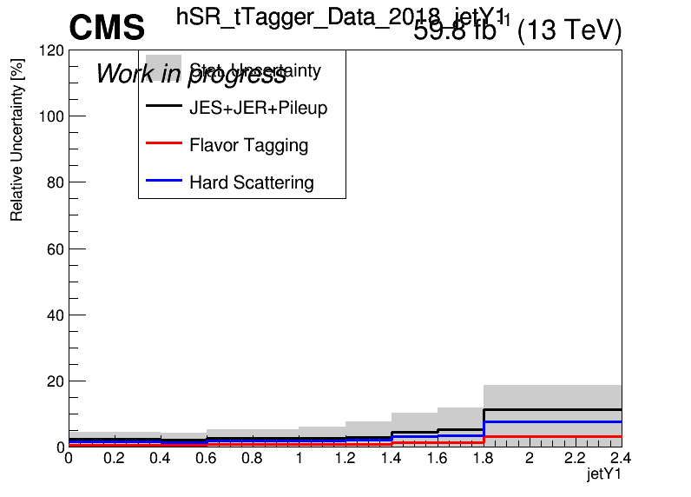
Errors in Fiducial Signal Extraction (Work In Progress)
2016_preVFP
2017
2016_postVFP
2018

Slide 15
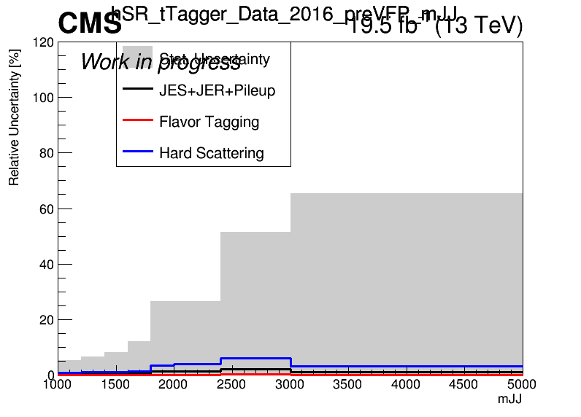
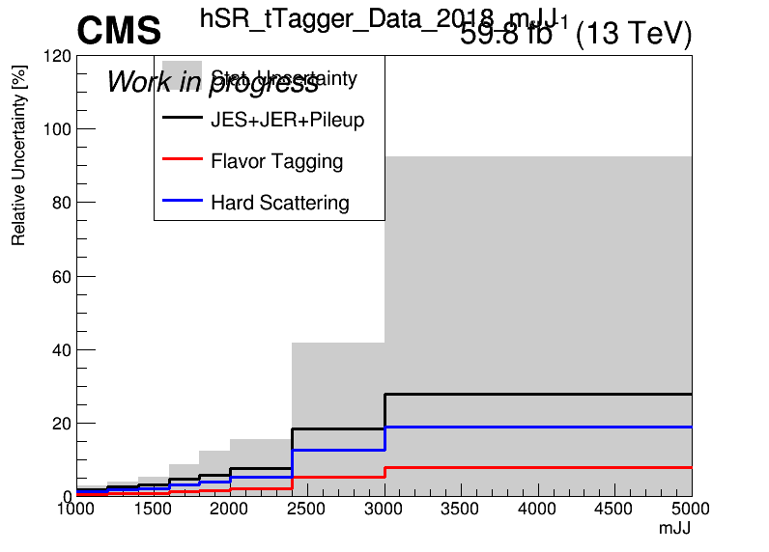
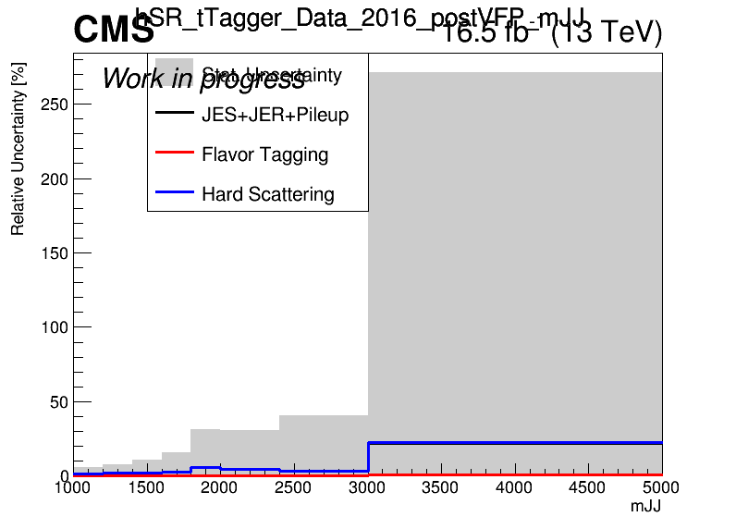
Errors in Fiducial Signal Extraction (Work In Progress)
2016_preVFP
2017
2016_postVFP
2018

Slide 16
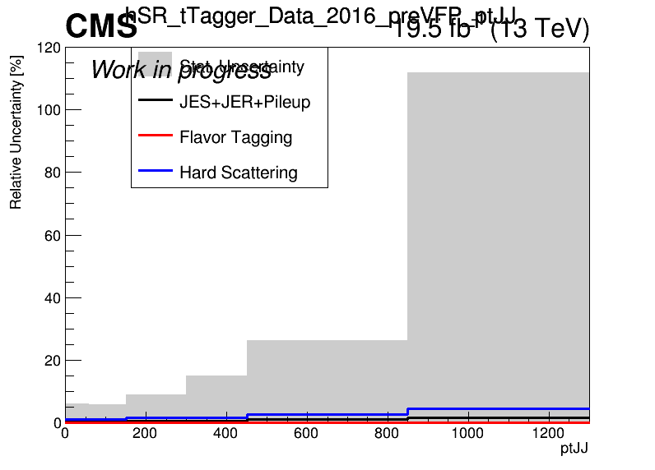
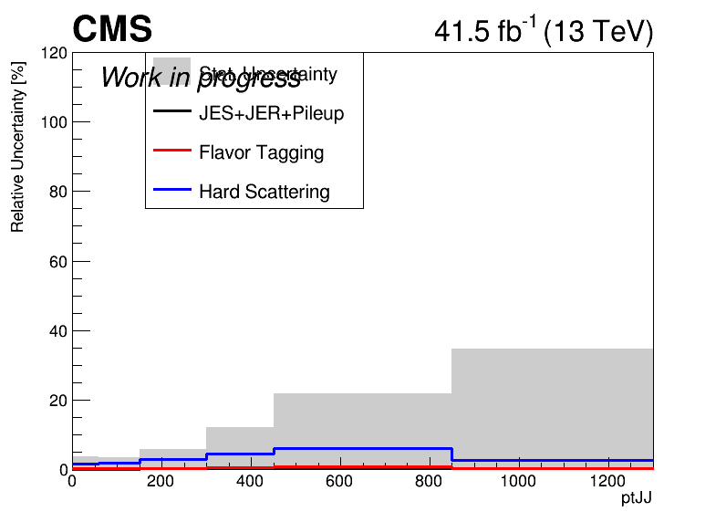
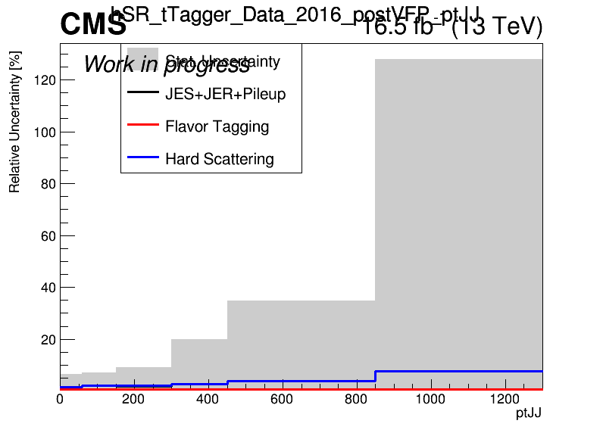
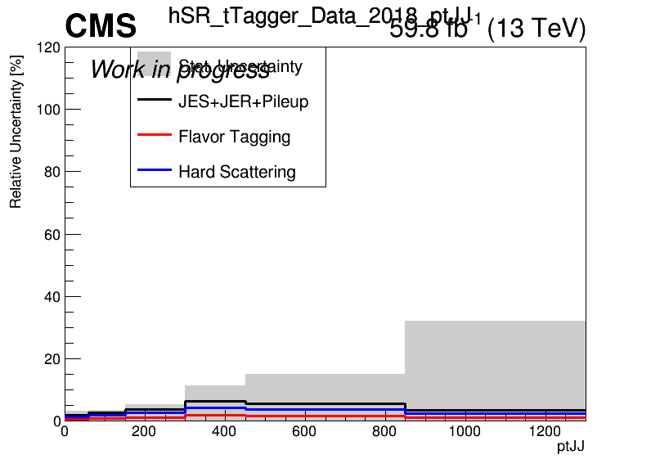
Errors in Fiducial Signal Extraction (Work In Progress)
2016_preVFP
2017
2016_postVFP
2018

Slide 17
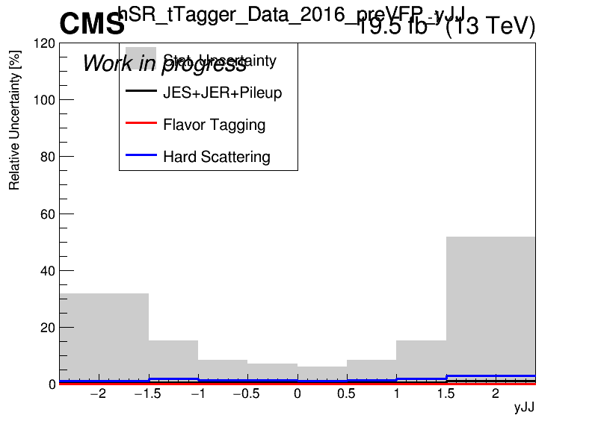
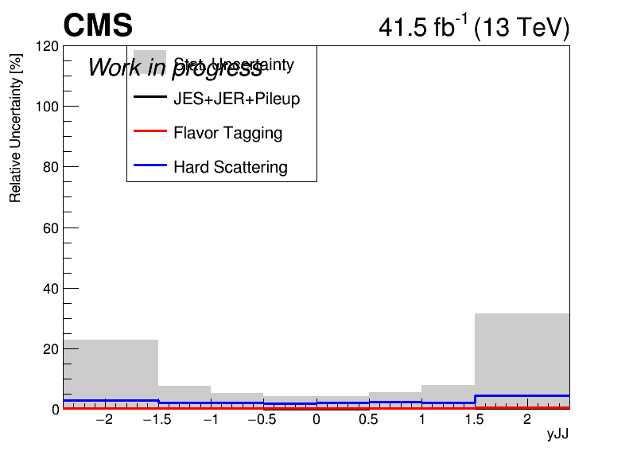
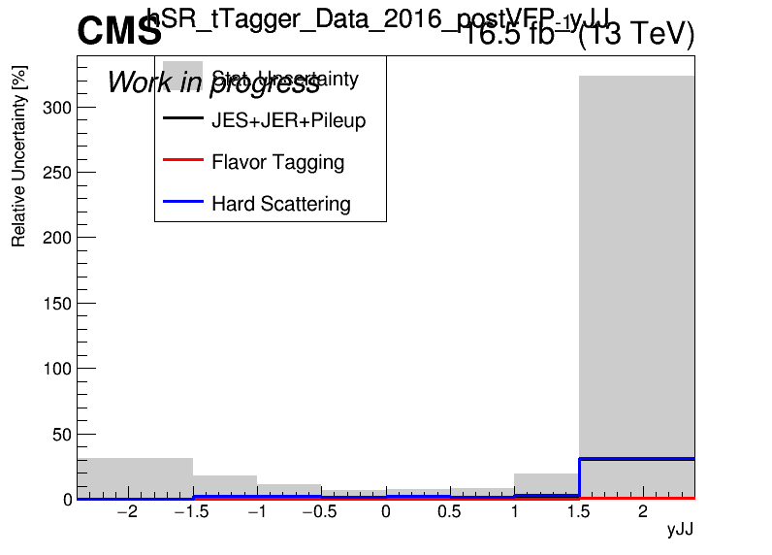
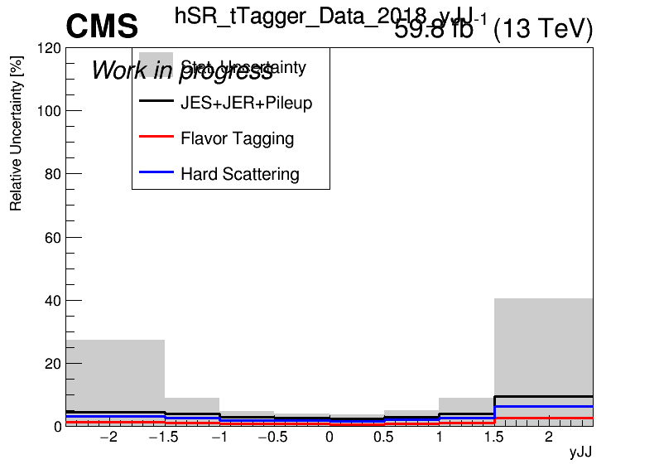
Errors in Fiducial Signal Extraction (Work In Progress)
2016_preVFP
2017
2016_postVFP
2018

